Slide 1
CAB BOOKING / Indrive
Presented by: Ahmad Hassan Shahzad & Muhammad Ibrahim ( 42896 )
Aanis Ishaq ( 51712 )

Slide 2
Introduction
The cab booking app connects passengers with nearby drivers.
Efficient real-time search is critical to user experience and revenue.
This study compares search algorithms for geolocation matching and proposes an optimized hybrid model.

Slide 3
Problem Statement
Goal: Match the nearest available driver to a passenger in real-time.
Challenges:
- Multiple users and dynamic geolocations
- High performance (<500ms)
- Scalable to thousands of requests

Slide 4
Literature Review
Linear & Binary Search: Too basic for real-time spatial data.
k-d Tree: Fast nearest neighbor in k-dimensional space.

Slide 5
Algorithm Comparison Table
Algorithm | Purpose | Time Complexity | Use Case
Linear Search | Sequential scan | O(n) | Simple, not scalable
k-d Tree | Nearest neighbor search | Insert: O(log n) | Optimal for static spatial data

Slide 6
Linear Search
k-d Tree
✅ Simple to implement
❌ Slow on large data (O(n))
Not suitable for real-time use
✅ Fast NN search in 2D/3D space
✅ Good average performance (O(log n))
❌ Requires rebalancing for dynamic updates

Slide 7
A - Tree
✅ Great for spatial range queries
❌ Overlap in bounding boxes can slow down
Suitable for region-based lookups

Slide 8
Recommendation
🔹 Use k-d Tree for quick nearest-driver search
🔹 Use priority queues to filter drivers (e.g., rating, availability)
📌 Ensures both speed and intelligence in driver selection

Slide 9
Experimental Setup
Test Datasets: 100, 10,000, 1M drivers
Edge Case: All drivers in one area
Metrics: Search Time, Accuracy, Memory Usage
Result: k-d Tree outperformed all others in real-time lookup

Slide 10
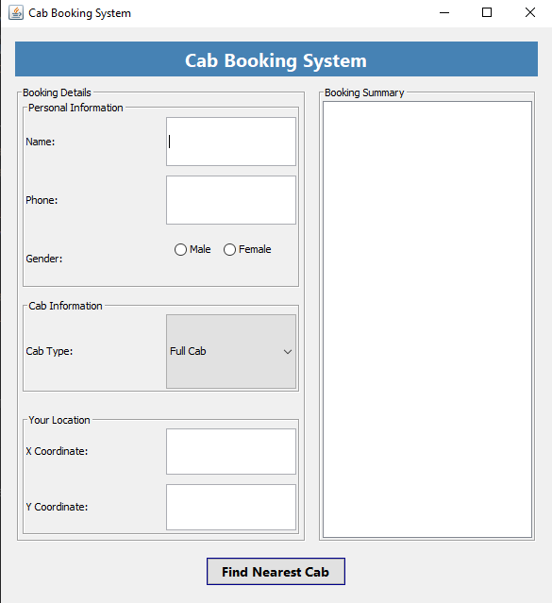
Output

Slide 11
Conclusion
k-d Tree is the best for real-time nearest-neighbor searches
Linear Search is not scalable
A hybrid solution combining k-d Tree and A* provides robust performance

